Slide 1




Towards delay-aware container-based
Service Function Chaining in Fog Computing
José Santos, Tim Wauters, Bruno Volckaert, Filip de Turck
IEEE/IFIP Network Operations and Management Symposium (NOMS 2020)
20 – 24 April 2020 – Budapest, Hungary

Slide 2
Outline
How can we deal with Service Function Chaining (SFC) in Fog Computing?
How can we support SFC in Fog Computing?
How can we evaluate our approach?
Notes:
Today, I am going to talk about…

Slide 3
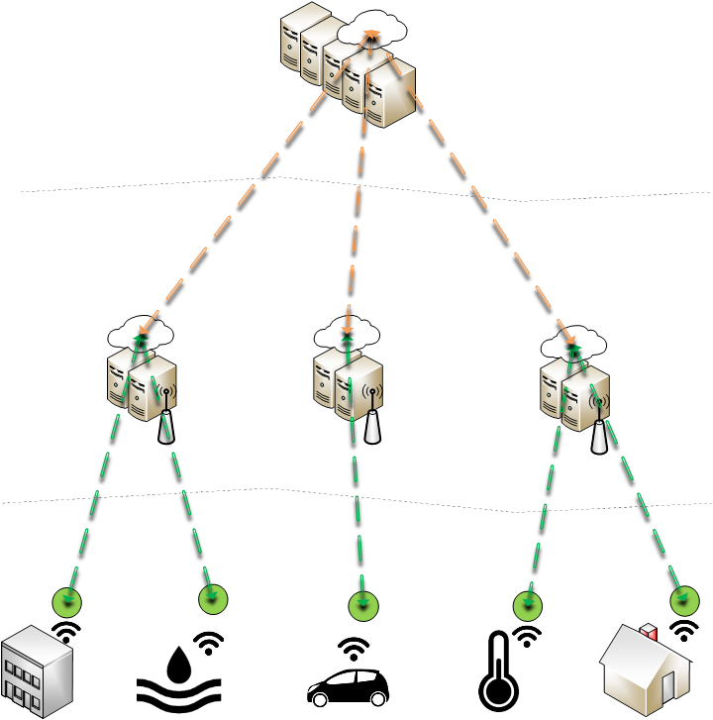
Fog Computing
Cloud
High Computing Power
High Latency
Fog
Medium Computing Power
Low Latency
IoT Devices
Low Computing Power
Notes:
Fog Computing aims to provide a distributed cloud infrastructure by placing computational resources close to end-users.

Slide 4
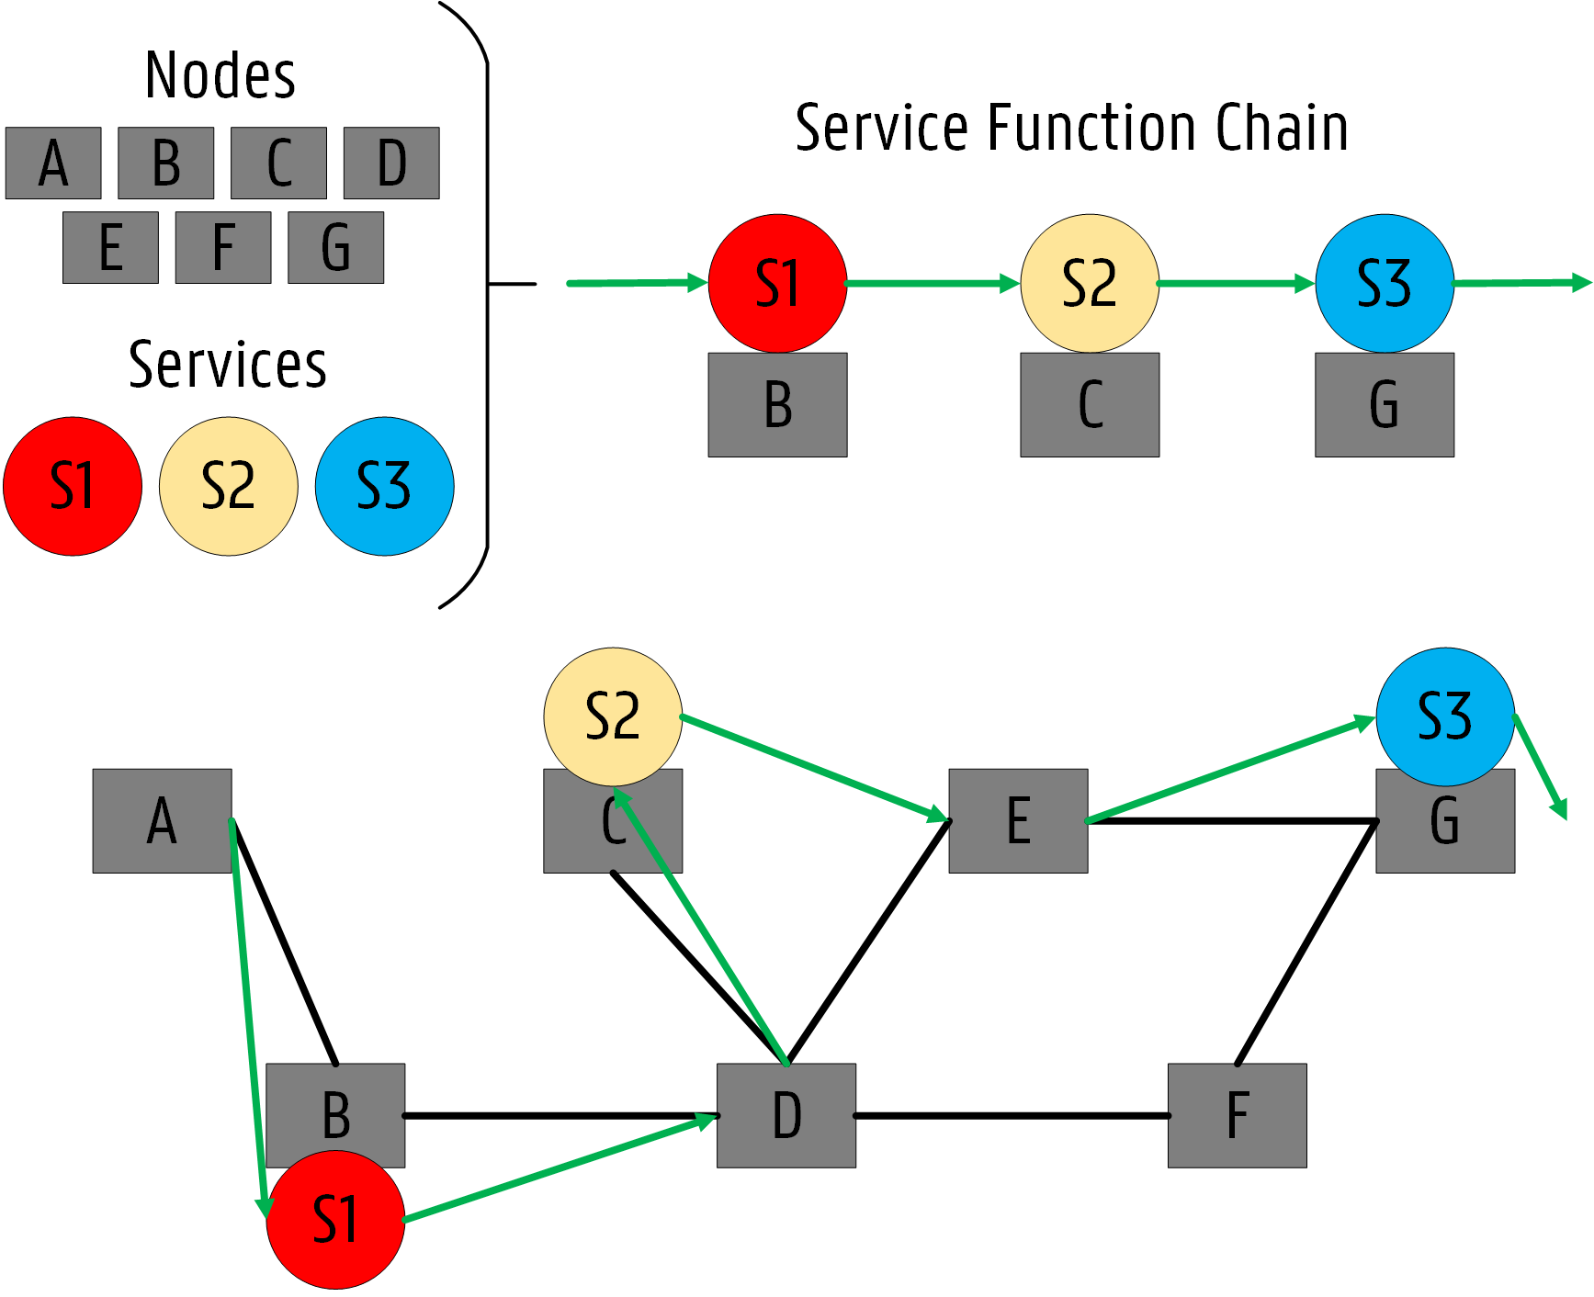
Service Function Chaining (SFC)
How can we incorporate SFC in Fog Computing?
Notes:
To fully leverage on NFV, services must be connected in a specific order forming a Service Function Chain (SFC). SFCs allow mobile operators to benefit from the
high flexibility and low operational costs introduced by network softwarization.
Services must be connected in a specific order forming an SFC that each user must traverse to achieve a Network Service
However, most SFC research only focuses on Multi-access Edge Computing (MEC) use cases where mobile operators aim to deploy services close to end-users. Bi-directional communication between Edges and Cloud are not considered in MEC, which in contrast is highly important in a Fog environment as in distributed anomaly detection services.

Slide 5
Outline
How can we deal with Service Function Chaining (SFC) in Fog Computing?
How can we support SFC in Fog Computing?
How can we evaluate our approach?
Notes:
So how can he support SFC in Fog Computing?
This question is answered next…

Slide 6
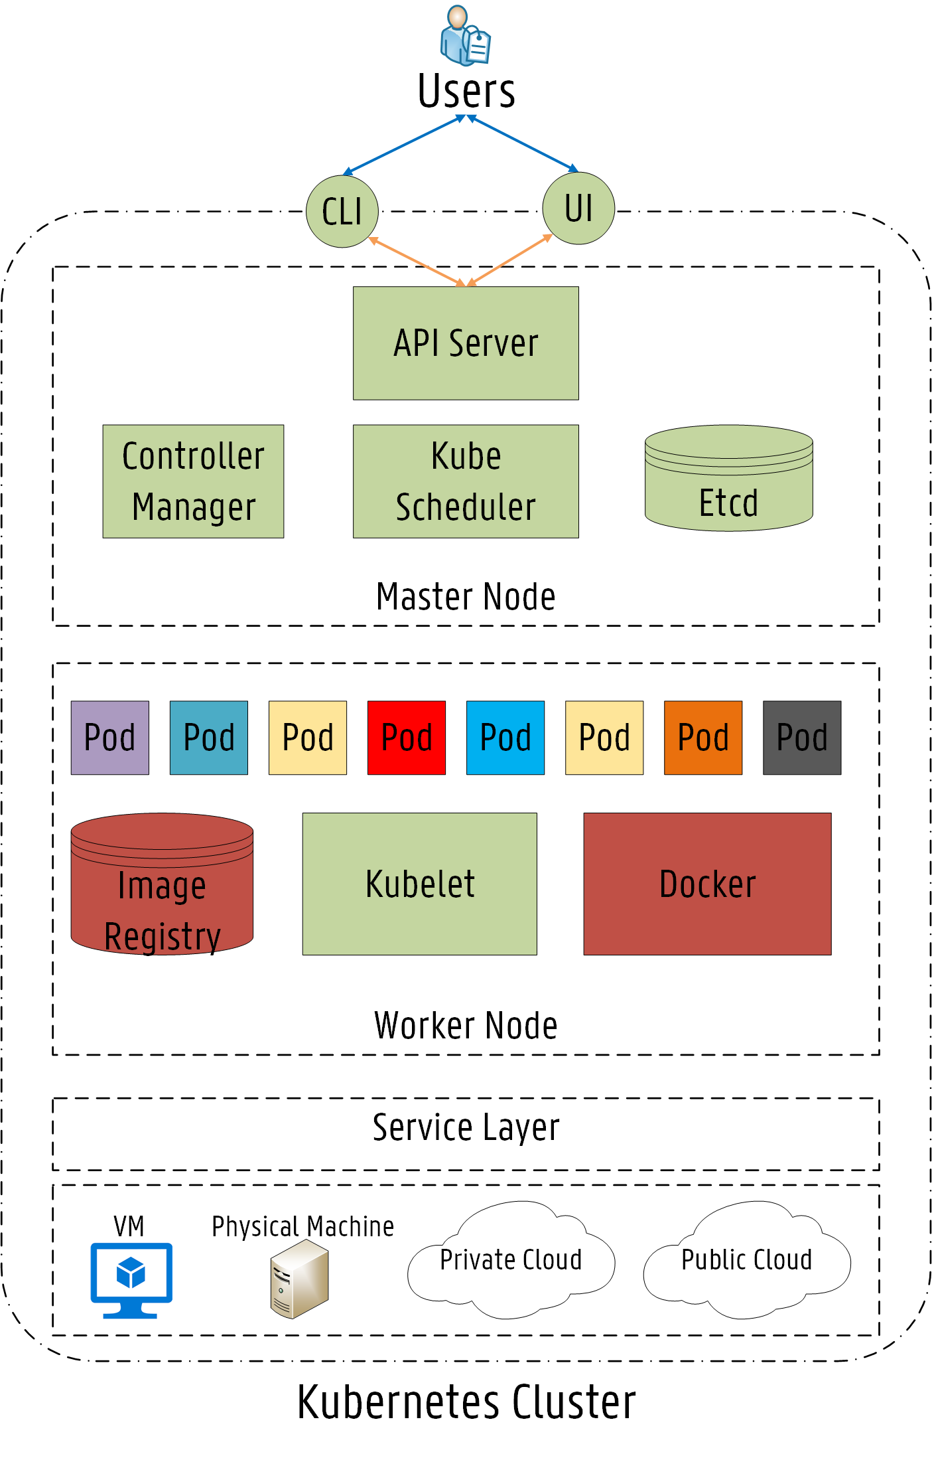

Kubernetes
Container Orchestration Platform
Robust & Reliable
Scaling up Containers (Docker)
Massive Open Source Community
Notes:
So he tried to see if we could apply SFC concepts in Kubernetes…
Kubernetes is essentially an open-source orchestration platform for containerized applications.
Kubernetes simplifies the deployment of reliable, scalable distributed systems by managing their complete life-cycle work-flow.
Kubernetes enables the automatic scaling of containers through Docker
Kubernetes has a massive open source community which is constantly working towards its improvement
Due to all of this, Kubernetes is positioning itself as the de facto platform for the orchestration of container based services.
Now, you will learn about the main features/characteristics of the Kubernetes architecture.
The architecture follows the master slave model, where at least one master node manages Docker containers across multiple worker nodes (slaves). These worker nodes can be local physical servers and VMs or even public and private clouds. The Master is responsible for exposing the API server, scheduling the service deployments and managing the overall cluster. The API server provides an entry point to control the entire Kubernetes cluster.

Slide 7
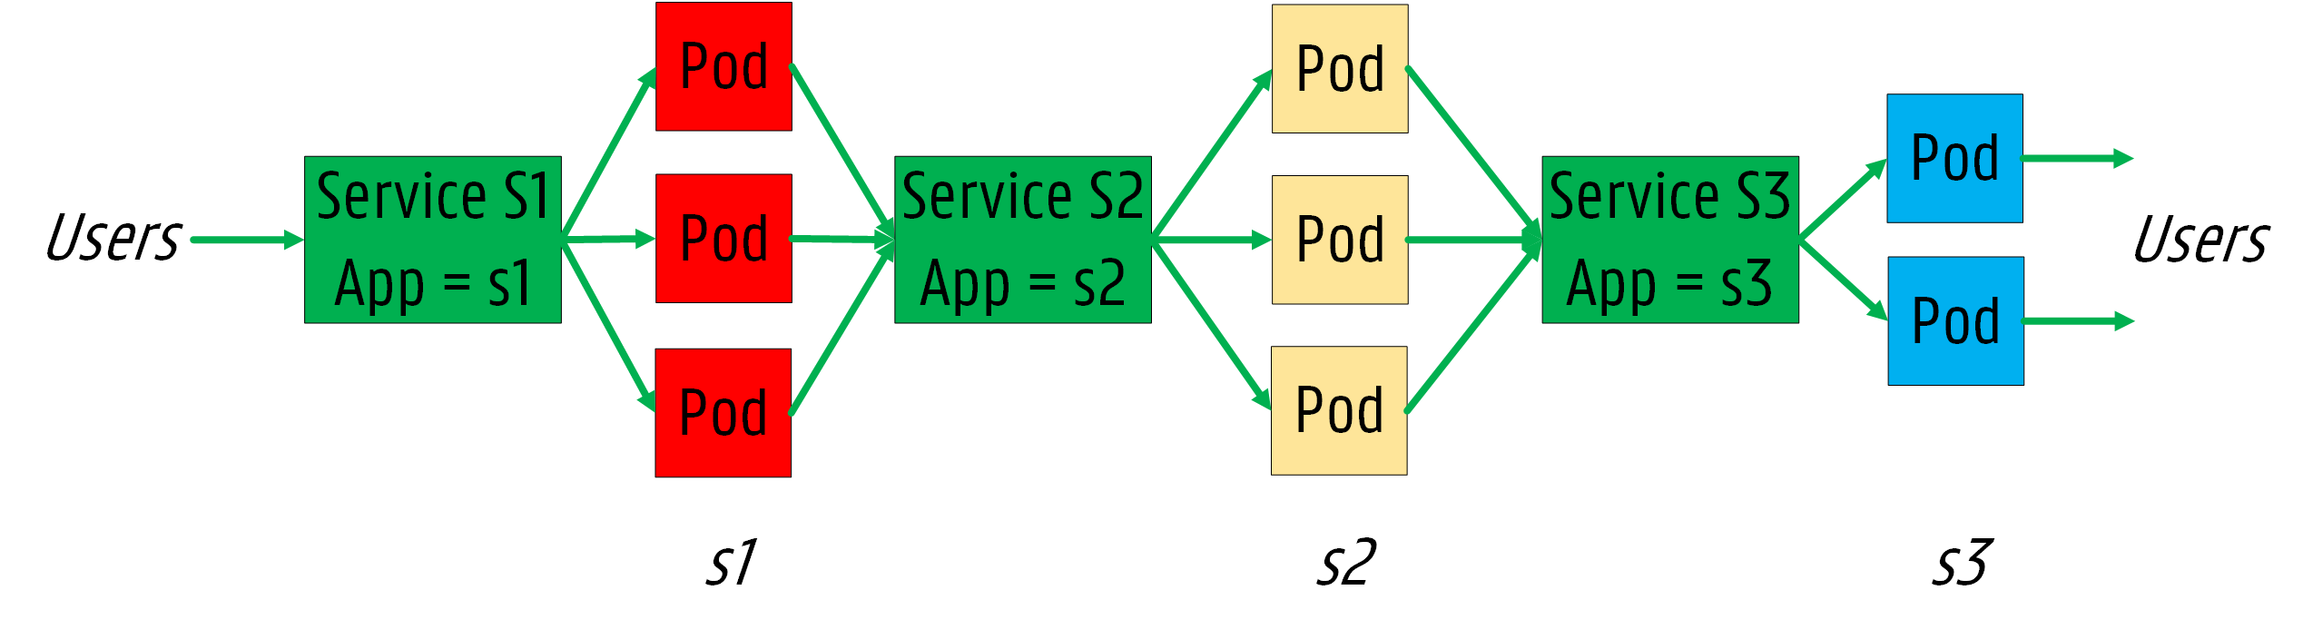
SFC concepts in Kubernetes
Notes:
To fully understand our approach, two concepts coming from Kubernetes should be highlighted: Pods and Services.
A pod represents the collection of containers and storage (volumes) running in the same execution environment, meaning that micro-services in Kubernetes are often coupled together forming a group of containers.
A Service is an abstract way to define a logical set of Pods and expose the applications running on them.
By using these two abstractions, there is no need to use a service discovery mechanism since pods have their own IP address, which makes load-balancing a straightforward process across them. The rationale behind these abstractions comes from the pods’ volatility as they may be terminated, meaning that pods running at a certain moment may be different than the ones which are providing the service a few days later. Thus, users must not need to be aware that pods have been terminated and new ones have been deployed.

Slide 8
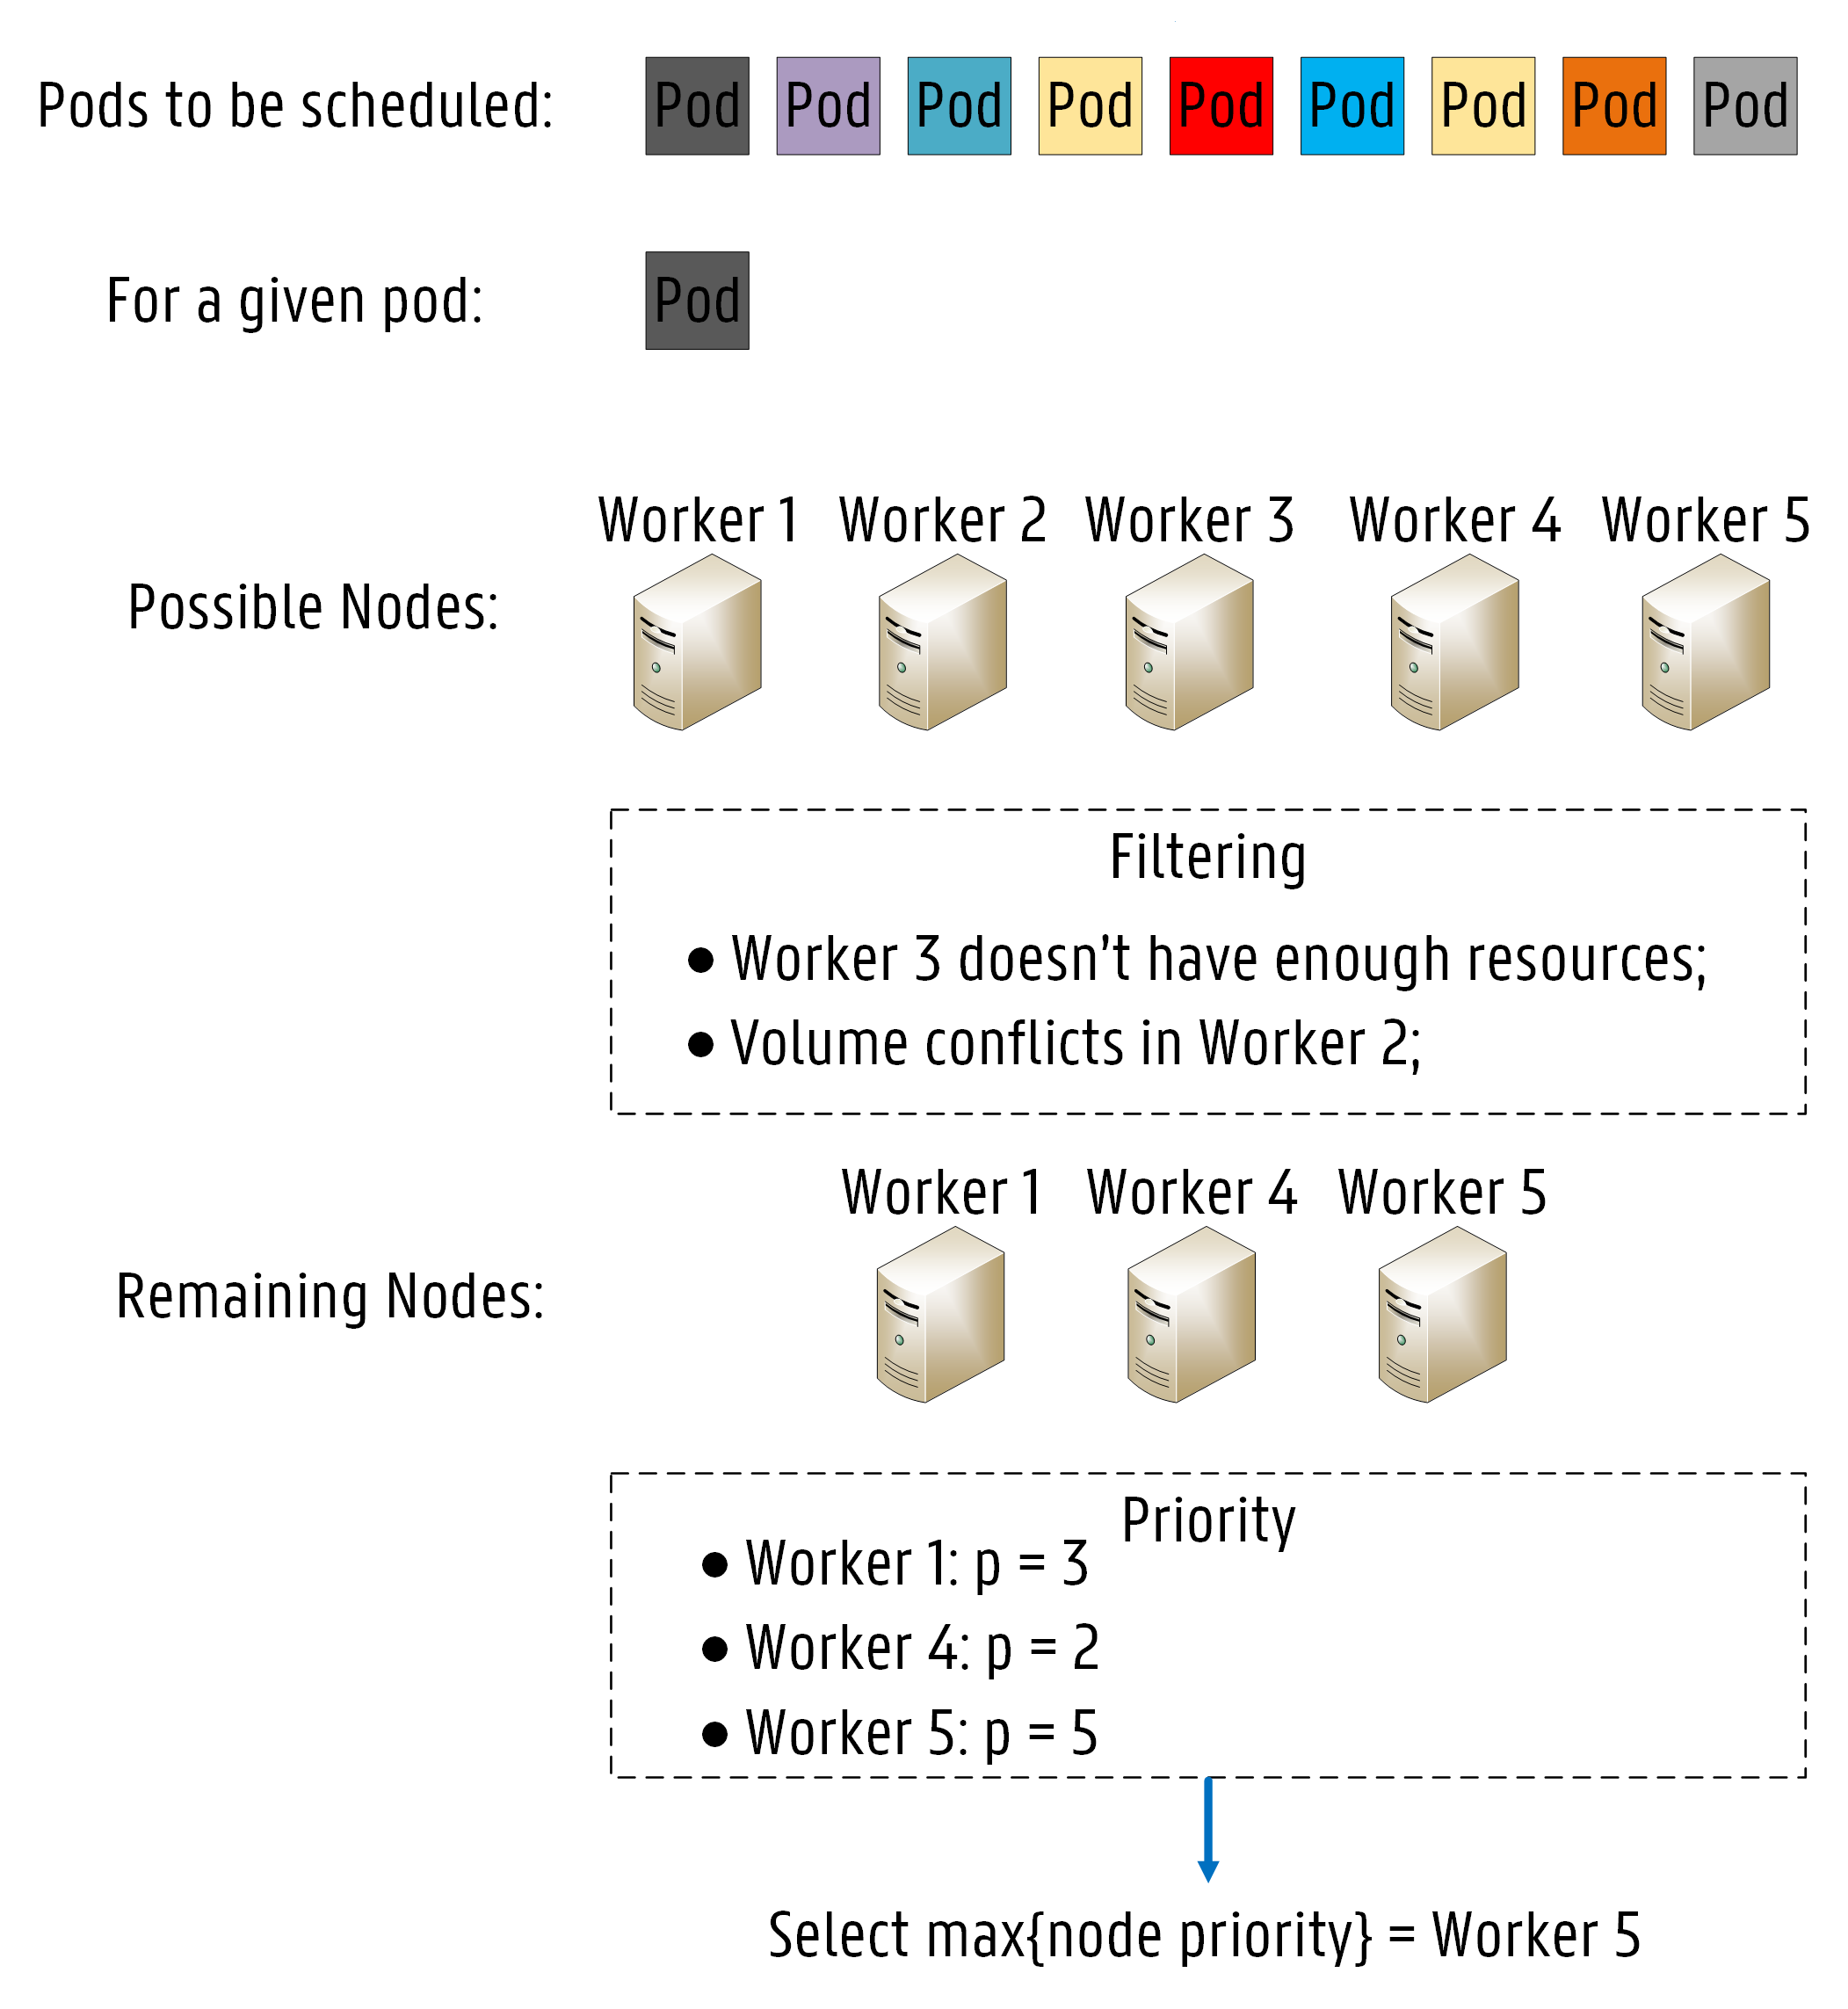
Kube-Scheduler (KS)
How does it work?
1
Node Filtering
2
Node Priority Calculation
Notes:
The component that makes decisions in terms of pod allocations in Kubernetes is called Kube–Scheduler (KS). The KS is the default scheduling feature in the Kubernetes platform, which is responsible for deciding on which nodes pods should be
allocated.
How does It work?...
Every pod needing allocation is added to a waiting queue, which is continuously monitored by the KS. If a pod is added to the waiting queue, the KS searches for a suitable node for the
deployment based on a two-step process. The first step is called node filtering, where the KS verifies which nodes can run the pod by applying a set of filters, also known as predicates.
The purpose of filtering is to solely consider nodes meeting all specific requirements of the pod further in the scheduling process.
The second operation is called node priority calculation, where the KS ranks each remaining node to find the best fit for the pod provisioning based on one or more scheduling algorithms, also called priorities.
Each algorithm is weighted and each node is scored between 0 and 10. The highest scoring node is chosen to run the pod.

Slide 9

Kube-Scheduler (KS)
Fast Decision Time
Easily extensible
Lack of specific rules
Only CPU and RAM
Notes:
One of the main strongest points of KS is the fast decision time in the order of ms (as I will shown further in my presentation).
KS is also easily extensible in case someone would like to make scheduling decisions on a specific rule/algorithm not yet present in the KS.
BUT Although KS provides flexible and powerful features, the metrics applied in the decision-making process are rather limited. Only CPU and RAM usage rates are considered in the service scheduling.
When Fog-cloud environments are considered, latency and bandwidth are highly challenging constraints.
For example, bandwidth limitations may cause network congestion and even service disruptions, which could eventually lead to service interruptions while latency thresholds if exceeded can lead to unstable services.
Therefore, for these kind of services, it is crucial to provide a provisioning approach considering multiple factors, such as the applications’ specific requirements (CPU and memory), the state of the infrastructure (hardware and software), the network status (link bandwidth and latency), among others.

Slide 10
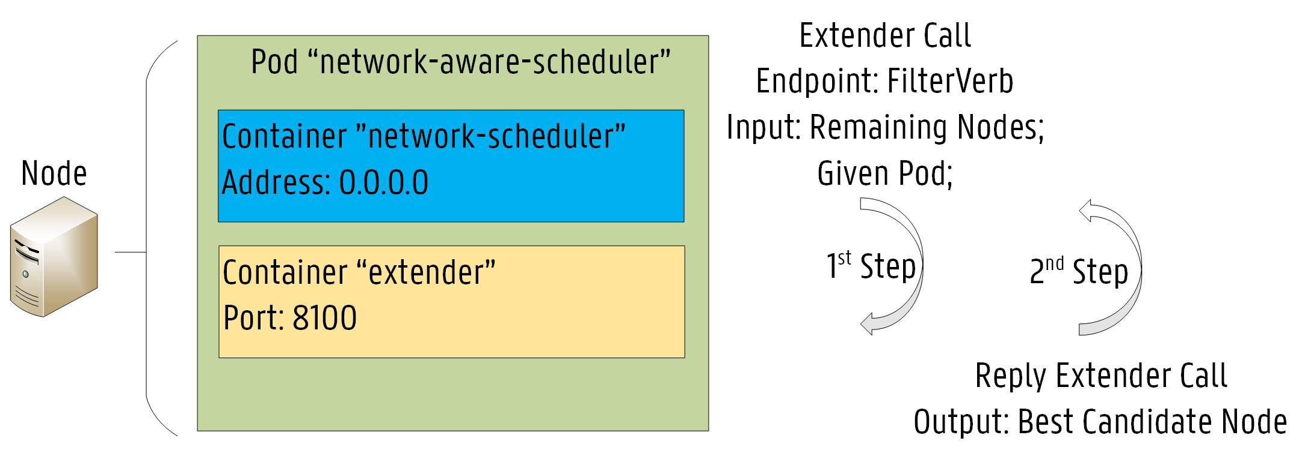
Network-Aware Scheduler
Implemented by extending KS:
1
Node Filtering
2
Minimization of RTT
Bandwidth Conservation
Santos, José, et al. "Towards Network-Aware Resource Provisioning in Kubernetes for Fog Computing applications." 2019 IEEE Conference on Network Softwarization (NetSoft). IEEE, 2019.
Notes:
In our previous work, we proposed a network-aware scheduling extension to Kubernetes, which provides service provisioning decisions based on up-to-date information about the current status of the network infrastructure.
Our Network-Aware Scheduler (NAS) is implemented by creating an “extender” process that the default KS calls out as a final step when making scheduling decisions. This extension approach is particularly suitable for use cases where scheduling decisions need to be made on resources not directly managed by the standard KS, which is exactly our case, since information on the current status of the network infrastructure is not available throughout the default scheduling process (KS).
We extended KS through the filter endpoint. The arguments passed on to the Filter endpoint consist of the set of nodes already filtered by KS and the given pod.
The NAS makes use of strategically placed RTT labels to decide where it is suitable to deploy a specific service based on the target location specified on the pod configuration file.
Round Trip Time (RTT) values are assigned to each node as a label so that delay constraints can be considered in the scheduling process. Furthermore, the available bandwidth on each node is also assigned as a label.
The node selection is based on the minimization of the RTT depending on the target location for the service after the completion of the filtering step.

Slide 11
SFC controller
Extension to the Network-Aware Scheduler:
1
SFC information in Pod configuration files
2
Provisioning strategies
Notes:
We extended our previous scheduler, now called SFC controller, with mainly two functionalities:
SFC information available as pod Labels in the Pod configuration files.
And also provisioning strategies based on latency and location.

Slide 12
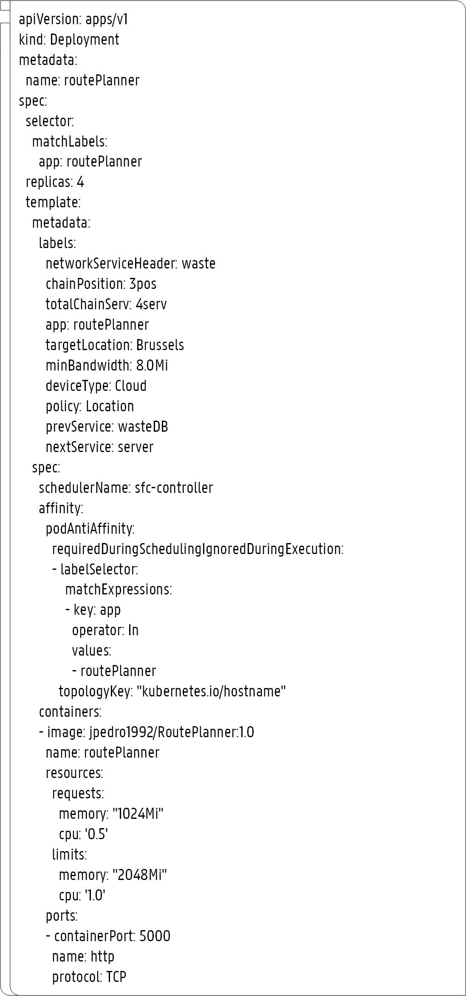
SFC controller
SFC information in Pod configuration files
1
Network Service Header
2
Chain Position
SFC Information
3
Total Services
4
Target Location
5
Minimum bandwidth
6
Policy
7
Previous Service
8
Next Service
Notes:
In terms of SFC information:
Network Service Header - The specific SFC identifier (String).
Chain Position - The position of the given pod in the SFC.
Total Services - The total number of services in the SFC.
Target Location - The preferred location for the deployment.
Policy - The preferred allocation policy.
Min Bandwidth - The minimum expected bandwidth.
Prev Service - The previous service in the SFC.
Next Service - The next service in the SFC..

Slide 13
SFC controller
Select Best Candidate Node
Main procedure
Policy == Location
Policy == Latency
Location-aware algorithm
Latency-aware algorithm
Node not available
Node available
MAX Residual Bandwidth Link
Store pod provisioning record
No Suitable Node!
Raise a Pod Eviction
Update node available bandwidth

Slide 14
Outline
How can we deal with Service Function Chaining (SFC) in Fog Computing?
How can we support SFC in Fog Computing?
How can we evaluate our approach?
Notes:
So Now, I will talk about our evaluation approach and show the results that we obtained.

Slide 15
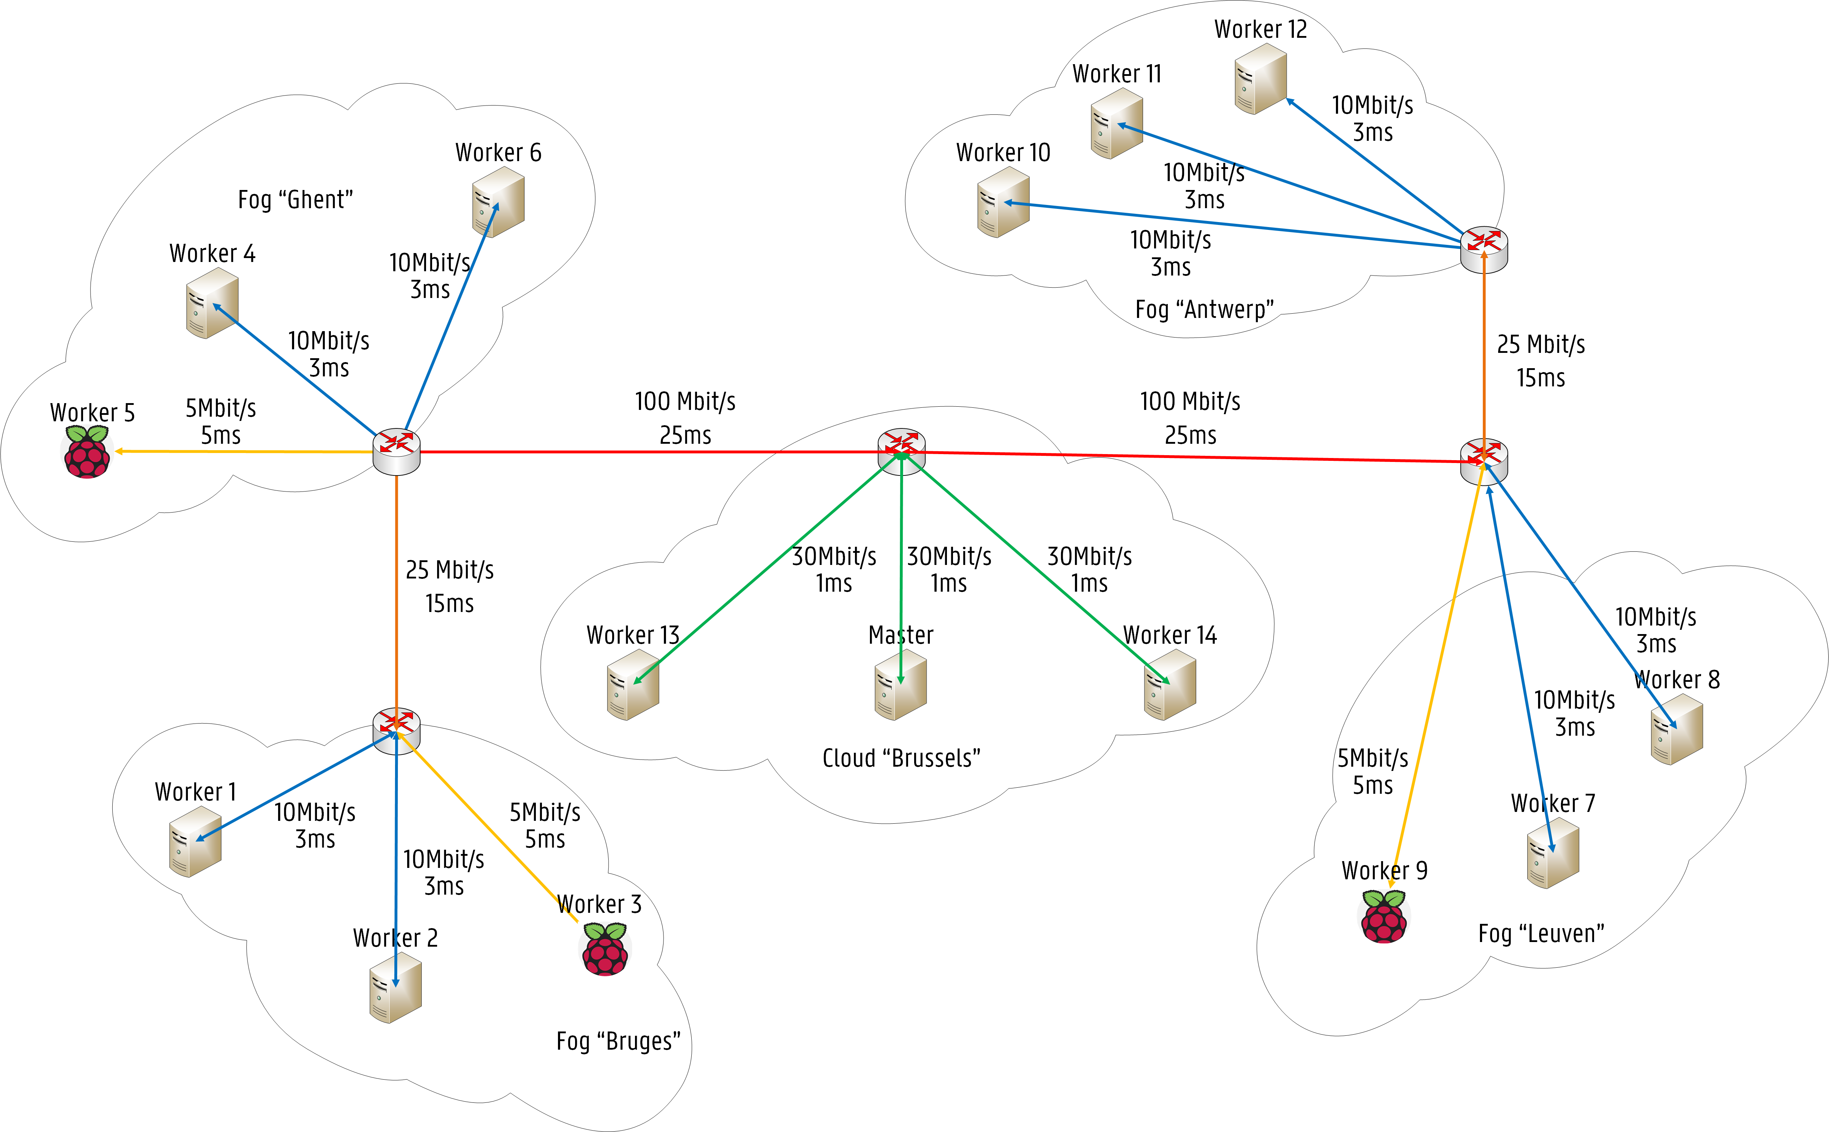
Evaluation Scenario
Delay Labels (e.g. Worker 1)
1
Bruges: 3.0 ms
2
Ghent: 18.0 ms
3
Antwerp: 83.0 ms
4
Leuven: 68.0 ms
5
Brussels: 43.0 ms
6
Av. Bandwidth: 10Mbit/s
Notes:
Our testbed infrastructure was composed by a Kubernetes cluster with 15 Nodes (1 Master, 14 Worker Nodes)
Nodes were assigned several labels. For instance, delay labels depending on the locations. For example, for worker 1…
A label is also used for the av. Band. On the node to keep track of the allocated band. …

Slide 16
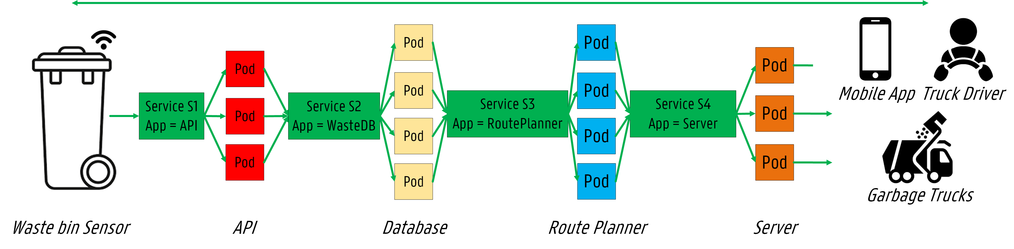
Use Cases
1
Waste Management
Notes:
Waste Management is viewed as one of the key services enabled by IoT technology in future Smart Cities [27]. Waste bins are located everywhere (e.g. restaurants, office buildings, retail stores), but picking up garbage has been traditionally an inefficient service for years. Garbage trucks follow a given route without knowing if bins are empty or full. Another issue is that waste bins may get overloaded before the planned cleaning. This results in high maintenance and fuel costs. IoT can tackle this issue by collecting waste bin data. For instance, sensors can be installed into waste bins to tell which bins are full. Furthermore, by sending the collected data to a fog- Cloud infrastructure, route planning services can be executed
to find the optimal route for each truck based on bin fill levels. Thus, drivers do not waste time driving to empty bins and broken bins may be repaired quickly. Trucks and drivers can access this service through a dashboard available as a mobile application, enabling them to improve their customer service. Therefore, an IoT-based waste management service provides a more efficient waste collection through route optimization and higher driver productivity. The objective of this use case is to enable the real-time access to waste bin information. In Fig. 5, the container-based SFC for the waste management use case is illustrated and the correspondent deployment requirements are shown in Table III.

Slide 17
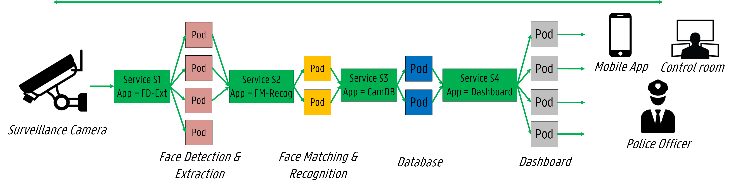
Use Cases
2
Surveillance Camera
Notes:
Over the last few years, crowd surveillance has become increasingly important due to the possibility of identifying individuals or even objects in highly crowded areas. Nevertheless,
several issues still need to be addressed, including data transfer over limited bandwidth and high latency in sensor-Cloud communication. For instance, imagine a surveillance camera requiring a continuous streaming bandwidth of 15 Mb/s. Sending the entire data from the video camera to the Cloud translates into approximately 4.86 TB/monthly for a single camera. Therefore, it is essential to adopt Fog infrastructures to perform data analysis operations locally, thus reducing the amount of data transferred to the Cloud. Surveillance cameras placed on particular streets or crowded areas send continuous video streams to a Fog-Cloud infrastructure where face recognition algorithms are performed in a distributed manner. Fog nodes located close to the surveillance cameras receive their video streams and perform a first-level analysis, such as face detection and feature extraction tasks. Then, Fog nodes send the results to the Cloud for global analysis operations, such as face matching and recognition operations. Afterwards, global outcomes can be presented in a central dashboard in a control room. Additionally, police officers may access the detection results through a mobile application. This distributed approach has been previously presented in [28], as a proper manner to enable anomaly detection in Fog Computing architectures for delay-sensitive IoT services. An IoT-based surveillance camera service provides a more efficient way of recognizing individuals in crowded areas by
distributing tasks between Fog and Cloud. The objective of this use case is to provide a near real-time face detection system.

Slide 18
Deployment Properties (e.g. waste management use case)
1
api
Replication Factor: 3
Chain Position: 1
Total Services: 4
Policy: Latency-Aware
Target Location: Any
Min. Bandwidth: 4.0 Mbit/s
Prev Service: None
Next Service: waste-db
2
route-planner
Replication Factor: 4
Chain Position: 3
Total Services: 4
Policy: Location-Aware
Target Location: Brussels
Min. Bandwidth: 8.0 Mbit/s
Prev. Service: waste-db
Next Service: server

Slide 19
Results
Notes:
Now, I am going to show you some of our results…

Slide 20
Execution Time
 | Extender Decision | Scheduling Decision | Pod Startup Time
KS | 0 ms | 3.21 ms | 2.83 s
SFC controller | 6.08 ms | 8.38 ms | 2.96 s
Notes:
On average KS decides in 3ms. The extender call is not issued thus the 0ms.
Our scheduler takes longer since the extender call is issued to decide in terms of latency and Band. The SFC controller requires on average between 6 - 7 ms.
Essentially, our approach takes 6 - 8 ms more than the KS.
The pod startup time is the time between the submission of the pod configuration file to the Kubernetes API and until the pod is deployed on a given node and ready to be used. Both KS and SFC controller require on average 3 seconds.
Now, let’s see if by increasing the scheduling decision in 6ms we could gain in other aspects…

Slide 21
Allocation Scheme
Use Case | Services | KS | SFC Controller
 | api | [Worker 5, Worker 11, Worker 12] | [Worker 3, Worker 5, Worker 7]
 | waste-db | [Worker 1, Worker 4, Worker 10, Master] | [Worker 4, Worker 10, Worker 11, Worker 14]
 | route-planner | [Worker 1, Worker 4, Worker 11, Master] | [Worker 6, Worker 13, Worker 14, Master]
 | server | [Worker 6, Worker 10, Master] | [Worker 13, Worker 14, Master]
 | fd-ext | [Worker 1, Worker 4, Worker 5, Worker 12] | [Worker 1, Worker 2, Worker 12, Master]
 | fm-recog | [Worker 3, Worker 4] | [Worker 13, Master]
 | cam-db | [Worker 3, Worker 4] | [Worker 7, Worker 8]
 | dashboard | [Worker 1, Worker 4, Worker 10, Master] | [Worker 8, Worker 9, Worker 10, Worker 11]
Notes:
As expected, the KS deployment scheme is not optimized for the service’s desired location or service latency, since no considerations are made about
location or latency in its scheduling algorithm. Thus, KS allocates multiple pods on a single node since it tries to balance the load in the cluster according to CPU and RAM usage rates.
For instance, the KS allocation scheme for the route planner or the fm-recog service is fairly poor since no pods are deployed in the preferred location (Brussels).

Slide 22
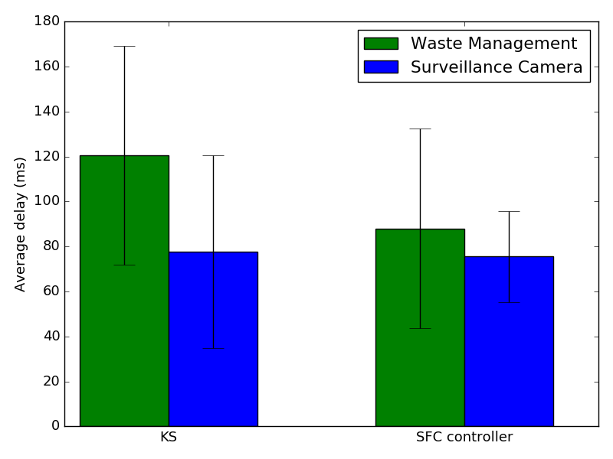
Average Service Latency
18%
Fig. 8: The expected service latency for each of the schedulers.
Notes:
In Fig. 8, the expected service latency for each of the schedulers is detailed. As shown, the proposed SFC-controller achieves lower delays for each of the deployed services when compared with the default KS. In spite of overloading several nodes, KS is not able to find optimal paths for the SFCs. The proposed SFC controller can optimize the SFC latency while conserving network bandwidth. In this particular allocation scheme, the SFC-controller improves the performance of the default KS by reducing the network latency by 18%.

Slide 23
Network Bandwidth
Worker Node | KS (Mbit/s) | SFC Controller (Mbit/s)
Worker 1 | 26.0 | 8.0
Worker 2 | - | 8.0
Worker 3 | 10.5 | 4.0
Worker 4 | 36.5 | 5.0
Worker 5 | 12.0 | 4.0
Worker 6 | 4.0 | 8.0
Worker 7 | - | 6.5
Worker 8 | - | 7.5
Worker 9 | - | 5.0
Worker 10 | 14.0 | 10.0
Worker 11 | 12.0 | 10.0
Worker 12 | 12.0 | 8.0
Worker 13 | - | 20.0
Worker 14 | - | 17.0
Master | 22.0 | 28.0
KS Overloads several nodes!
1
Worker 1: 26.0 Mbit/s
2
Worker 3: 10.5 Mbit/s
3
Worker 4: 36.5 Mbit/s
4
Worker 5: 12.0 Mbit/s
5
Worker 10: 14.0 Mbit/s
6
Worker 11: 12.0 Mbit/s
7
Worker 12: 12.0 Mbit/s
Notes:
In Table VII, the expected service bandwidth per node for the different scheduling approaches is presented. It should be noted that bandwidth values in bold mean that the cluster node is overloaded based on the available bandwidth previously shown in Fig. 4. As shown, KS allocates pods on nodes already compromised in terms of network bandwidth. For instance, KS overloads worker 1 and 4 by allocating to them at least 4 pods leading to service bandwidths of 26.0 Mbit/s and 36.5 Mbit/s for the workers 1 and 4, respectively, which surpasses the available bandwidth of 10.0 Mbit/s. This provisioning scheme may lead to service disruptions due to bandwidth fluctuations. In contrast, the proposed SFC controller takes into account the available bandwidth while making scheduling decisions, which leads to informed decisions not only in terms of latency but also in terms of bandwidth.

Slide 24
Conclusions
SFC Allocation in Fog computing
Validated in Kubernetes.
Results
18% reduction of service latency while conserving bandwidth
Future Work
Dynamic strategies added to our SFC controller
Notes:
SFC allocation for IoT in Fog Computing based on latency & band. Validated in Kubernetes
We obtained a reduction of 18% (service latency) when compared with the default KS.
As future work, dynamic strategies will be added to our SFC controller to further refine the allocation scheme in terms of bandwidth fluctuations and delay changes.

Slide 25

Thank you for your attention!
Questions?
José Santos
Ghent University – imec, IDLab
Josepedro.pereiradossantos@UGent.be
Interested?
Repository: github.com/jpedro1992/sfc-controller
Demo presentation: accepted for NETSOFT 2020
Notes:
Let me say that if you are interested in trying out our software or learn more about our approach, you have here the GitHub URL.

Slide 26
SFC controller
Latency-aware algorithm
Latency-aware algorithm
Select node based on Shortest Paths calculation
node
If node == null
If node != null
Location-aware algorithm
Return node

Slide 27
SFC controller
Location-aware algorithm
Location-aware algorithm
Repeat the process! (Recursive)
Select node based on minimum Delay for target location
node
If node does not have enough bandwidth
If node has enough bandwidth
Remove Node from Potential Candidates
Return node
Node List != null
Node List == null
Return null

Slide 28
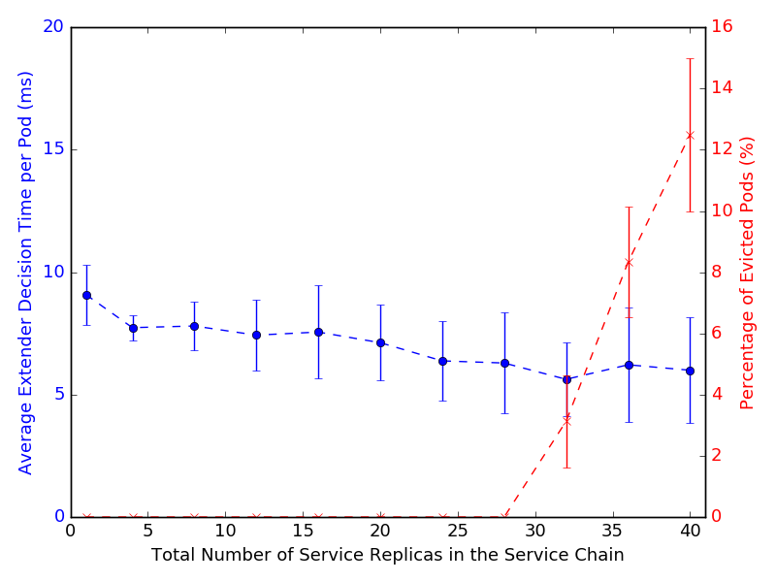
Scalability
Fig. 9: The average execution time per Pod of the SFC controller extender call.
Notes:
In Fig. 9, the execution time per Pod of the SFC controller extender call is shown. The number of service replicas is increased to evaluate how the SFC controller handles the allocation of a high number of service instances in the Service Chain. As shown, the extender decision time decreases while the number of service replicas increases, since only a small amount of nodes will still be free in terms of resources, specifically in terms of bandwidth based on the previously presented infrastructure. Increasing the number of replicas will also lead to pod evictions since nodes will already be exhausted and no node will be available for the service allocation. Nevertheless, the SFC controller can cope with a high number of replicas without compromising the decision time as long as resources are available.

